Slide 1
UNIT – 7 (Part 1)
Servlets and JSP

Slide 2
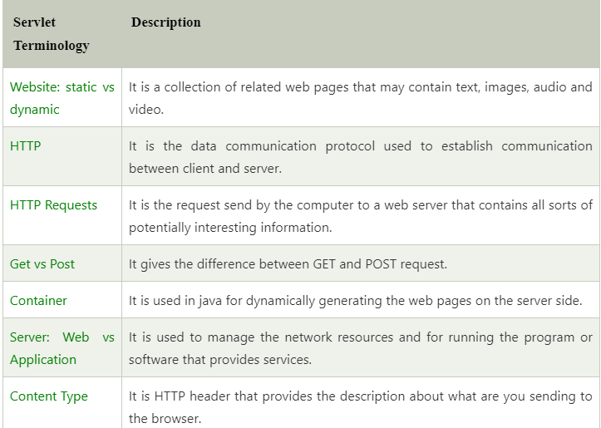
Web Terminology

Slide 3
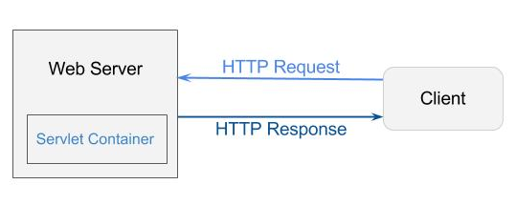

It provides the runtime environment for JavaEE (j2ee) applications. The client/user can request only a static Webpages from the server. If the user wants to read the web pages as per input then the servlet container is used in java. The servlet container is the part of web server which can be run in a separate process. We can classify the servlet container states in three types:
Standalone: It is typical Java-based servers in which the servlet container and the web servers are the integral part of a single program. For example:- Tomcat running by itself
In-process: It is separated from the web server, because a different program runs within the address space of the main server as a plug-in. For example:- Tomcat running inside the JBoss.
Out-of-process: The web server and servlet container are different programs which are run in a different process. For performing the communications between them, web server uses the plug-in provided by the servlet container.

Slide 4

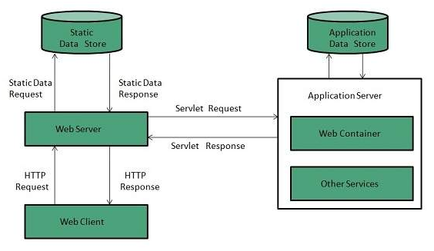
Server is a device or a computer program that accepts and responds to the request made by other program, known as client. It is used to manage the network resources and for running the program or software that provides services. There are two types of Servers:
Web Server
Application Server
Web Server
Web server contains only web or servlet container. It can be used for servlet, jsp, struts, jsf etc. It can't be used for EJB.
It is a computer where the web content can be stored. In general web server can be used to host the web sites but there also used some other web servers also such as FTP, email, storage, gaming etc.
Examples of Web Servers are: Apache Tomcat and Resin.

Slide 5
Web Server Working
It can respond to the client request in either of the following two possible ways:
Generating response by using the script and communicating with database.
Sending file to the client associated with the requested URL.
Important points
If the requested web page at the client side is not found, then web server will sends the HTTP response: Error 404 Not found.
When the web server searching the requested page if requested page is found then it will send to the client with an HTTP response.
If the client requests some other resources then web server will contact to application server and data is store for constructing the HTTP response.

Slide 6
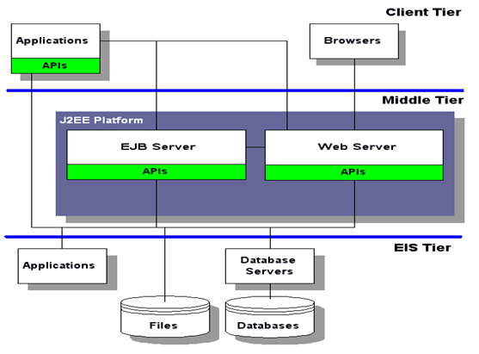
Application Server
Application server contains Web and EJB containers. It can be used for servlet, jsp, struts, jsf, ejb etc. It is a component based product that lies in the middle-tier of a server centric architecture.
It provides the middleware services for state maintenance and security, along with persistence and data access. It is a type of server designed to install, operate and host associated services and applications for the IT services, end users and organizations.
The Example of Application Servers are:
JBoss: Open-source server from JBoss community.
Glassfish: Provided by Sun Microsystem. Now acquired by Oracle.
Weblogic: Provided by Oracle. It more secured.
Websphere: Provided by IBM.

Slide 7
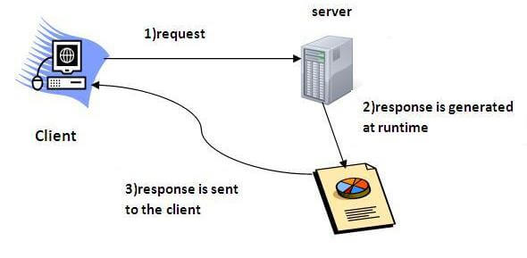
What is Servlets?
Servlet technology is used to create a web application (resides at server side and generates a dynamic web page).
Servlet is a web component that is deployed on the server to create a dynamic web page.
Properties of Servlets :
Servlets work on the server-side.
Servlets are capable of handling complex requests obtained from web server.

Slide 8
Execution of Servlets : Execution of Servlets involves six basic steps:
The clients send the request to the web server.
The web server receives the request.
The web server passes the request to the corresponding servlet.
The servlet processes the request and generates the response in the form of output.
The servlet sends the response back to the web server.
The web server sends the response back to the client and the client browser displays it on the screen.

Slide 9
What is CGI ?
The Servlet technology is similar to other Web server extensions such as Common Gateway Interface(CGI) scripts and Hypertext Preprocessor (PHP). However, Java Servlets are more acceptable since they solve the limitations of CGI such as low performance and low degree scalability.
CGI is actually an external application which is written by using any of the programming languages likeC or C++ and this is responsible for processing client requests and generating dynamic content.

Slide 10
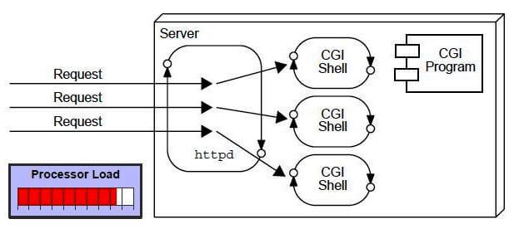
In CGI application, when a client makes a request to access dynamic Web pages, the Web server performs the following operations :
It first locates the requested web page i.e the required CGI application using URL.
It then creates a new process to service the client’s request.
Invokes the CGI application within the process and passes the request information to the server.
Collects the response from CGI application.
Destroys the process, prepares the HTTP response and sends it to the client.

Slide 11
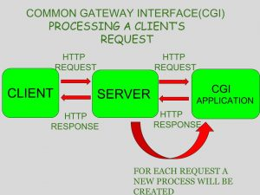
So, in CGI server has to create and destroy the process for every request. It’s easy to understand that this approach is applicable for handling few clients but as the number of clients increases, the workload on the server increases and so the time taken to process requests increases.

Slide 12
Disadvantages of CGI
There are many problems in CGI technology:
If the number of clients increases, it takes more time for sending the response.
For each request, it starts a process, and the web server is limited to start processes.
It uses platform dependent language e.g. C, C++, perl.

Slide 13
SERVLET | CGI(COMMON GATEWAY INTERFACE)
Servlets are portable and efficient. | CGI is not portable
In Servlets, sharing of data is possible. | In CGI, sharing of data is not possible.
Servlets can directly communicate with the web server. | CGI cannot directly communicate with the web server.
Servlets are less expensive than CGI. | CGI are more expensive than Servlets.
Servlets can handle the cookies. | CGI cannot handle the cookies.

Slide 14
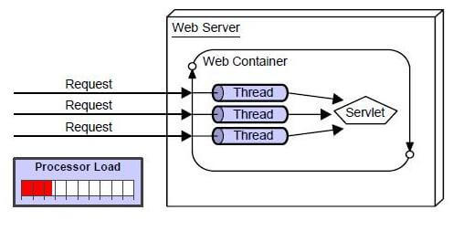
Advantages of Servlet
The web container creates threads for handling the multiple requests to the Servlet. Threads have many benefits over the Processes such as they share a common memory area, lightweight, cost of communication between the threads are low. The advantages of Servlet are as follows.
Better performance: because it creates a thread for each request, not process.
Portability: because it uses Java language.
Robust: JVM manages Servlets, so we don't need to worry about the memory leak, garbage collection, etc.
Secure: because it uses java language.
Servlets as written in Java are platform independent.

Slide 15
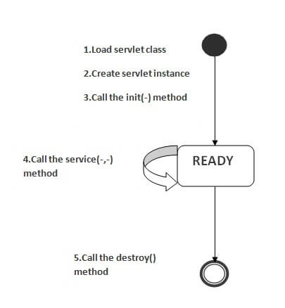
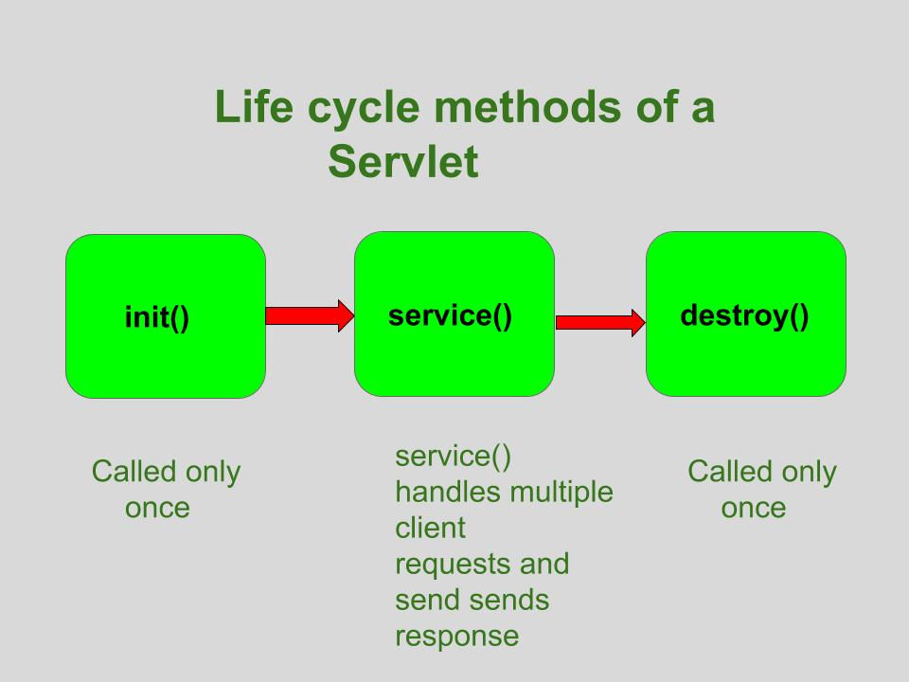
Life Cycle of a Servlet

Slide 16
1. init() method:
The Servlet.init() method is called by the Servlet container to indicate that this Servlet instance is instantiated successfully and is about to put into service.
public class MyServlet implements Servlet{
public void init(ServletConfig config) throws ServletException {
//initialization code
}
//rest of code
}

Slide 17
2. service() method: The service() method of the Servlet is invoked to inform the Servlet about the client requests. This method uses ServletRequest object to collect the data requested by the client. This method uses ServletResponse object to generate the output content.
public class MyServlet implements Servlet{
public void service(ServletRequest res, ServletResponse res)
throws ServletException, IOException {
// request handling code
}
// rest of code
}

Slide 18
3. destroy() method:
The destroy() method runs only once during the lifetime of a Servlet and signals the end of the Servlet instance.
As soon as the destroy() method is activated, the Servlet container releases the Servlet instance.
public void destroy()

Slide 19
How Servlet works?
The server checks if the servlet is requested for the first time.
If yes, web container does the following tasks:
loads the servlet class.
instantiates the servlet class.
calls the init method passing the ServletConfig object
else
calls the service method passing request and response objects

Slide 20
Why web.xml is used in servlets?
web. xml defines mappings between URL paths and the servlets that handle requests with those paths. The web server uses this configuration to identify the servlet to handle a given request and call the class method that corresponds to the request method (e.g. the doGet() method for HTTP GET requests).

Slide 21
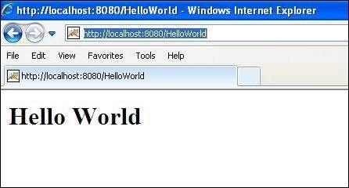
An Servlet Example (Hello World)

Slide 22
// Import required java libraries
import java.io.*;
import javax.servlet.*;
import javax.servlet.http.*;
// Extend HttpServlet class
public class HelloWorld extends HttpServlet {
private String message;
public void init() throws ServletException {
// Do required initialization
message = "Hello World";
}
public void doGet(HttpServletRequest request, HttpServletResponse response)
throws ServletException, IOException {
// Set response content type
response.setContentType("text/html");
// Actual logic goes here.
PrintWriter out = response.getWriter();
out.println("<h1>" + message + "</h1>");
}
public void destroy() {
// do nothing.
}
}

Slide 23
Compiling a Servlet
$ javac HelloWorld.java
above compilation would produce HelloWorld.class file in the same directory.
Servlet Deployment
create following entries in web.xml file located in <Tomcat-installation-directory>/webapps/ROOT/WEB-INF/
<servlet>
<servlet-name>HelloWorld</servlet-name>
<servlet-class>HelloWorld</servlet-class>
</servlet>
<servlet-mapping>
<servlet-name>HelloWorld</servlet-name>
<url-pattern>/HelloWorld</url-pattern>
</servlet-mapping>

Slide 24
Classwork
Demonstrate an example with addition of two numbers.
Video Tutorial of above example:
https://www.youtube.com/watch?v=4P_kI0cySIA

Slide 25
Steps to write Java Servlet Program
Step1:
Open Netbeans and click on File -> New Project, and select JAVA Web from categories pane, and Web Application from Projects pane, and click Next. In the second Window, provide name for your project and click Next. In the third Window, click Next and in the fourth window click Finish.
Step2:
When the project gets loaded completely, select your project from project window on the left side. If the project window is not shown, press ctrl+1 . Then, click on '+' icon near ‘web pages’ folder and double click the index.html file to open and edit the coding as per your requirement.

Slide 26
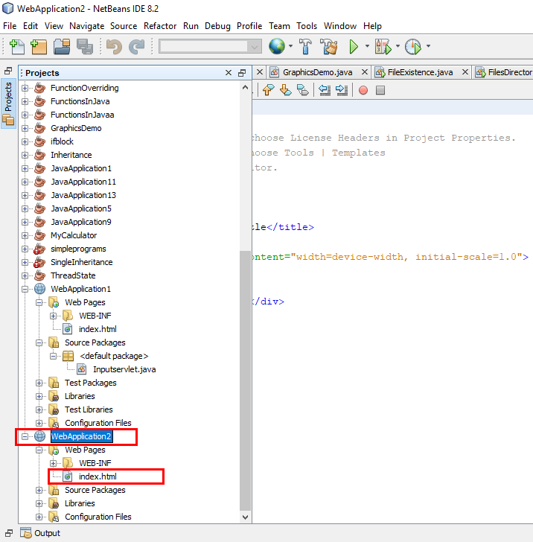
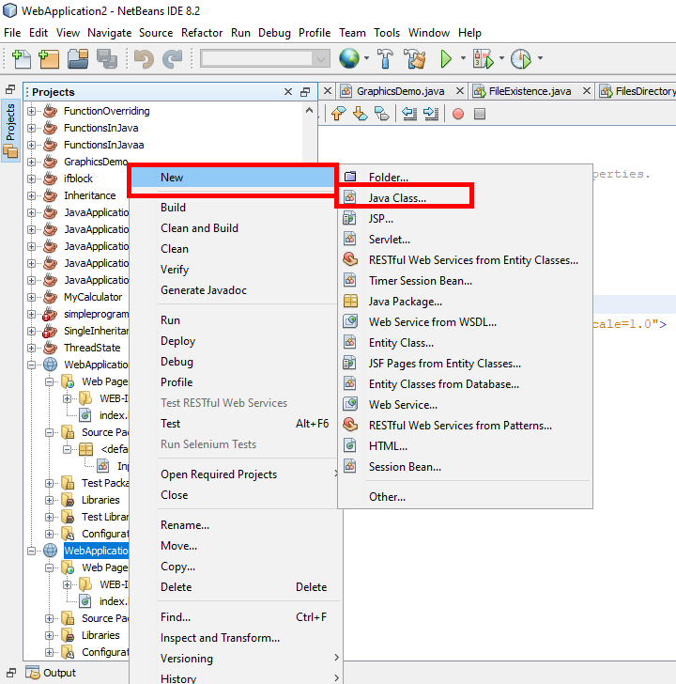

Slide 27
<!DOCTYPE html>
<html> <head>
<title>TODO supply a title <meta charset="UTF-8">
<meta name="viewport" content="width=device-width, initial-scale=1.0">
</head>
<body>
<form name='f1' action='inputservlet' method='post'>
First No. <input type='text' name='t1'>
Second No. <input type='text' name='t2'>
Output: <input type='text' name='output'>
<input type='submit' name='submit' value='submit'>
</form>
</body>
</html>
Step 3:
Edit the Contents of index.html file

Slide 28
import javax.servlet.http.*;
import javax.servlet.*;
import java.io.*;
import javax.servlet.annotation.WebServlet;
@WebServlet("/inputservlet")
public class Inputservlet extends HttpServlet
{
public void doPost(HttpServletRequest req,HttpServletResponse res)throws
IOException , ServletException
{
PrintWriter pr=res.getWriter();// line 10
res.setContentType("text/html");
Step 4:
Create a Servlet Class

Slide 29
catch(Exception e)
{
pr.println("Invalid Input");
}
}
}
try
{
int x=Integer.parseInt(req.getParameter("t1"));
int y=Integer.parseInt(req.getParameter("t2"));
int z=x+y;
pr.println("<HTML>");
pr.println("<HEAD><TITLE>Hello</TITLE></HEAD>");
pr.println("<BODY>");
pr.println("First No.<input type=text value=" +x +"><br><br>");
pr.println("Second No.<input type=text value=" +y +"><br><br>");
pr.println("Output No:<input type=text value=" +z +"><br><br>");
pr.println("<input type=submit value=submit>");
pr.println("</BODY></HTML>");
}

Slide 30
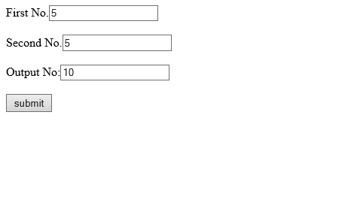
Output

Slide 31
Questions on Servlets
Compare and contrast between Servlets and Java Server pages? How web server responds to servlets and JSP page? Write down sample example. Handling HTTP Request and Response using servlets. [Model Question] [10]
Discuss different methods used in life cycle of servelet. [5] [2070, 2071]

Slide 32


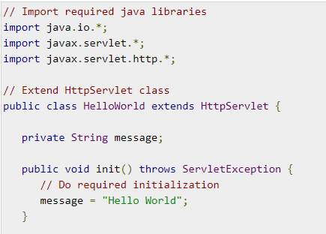
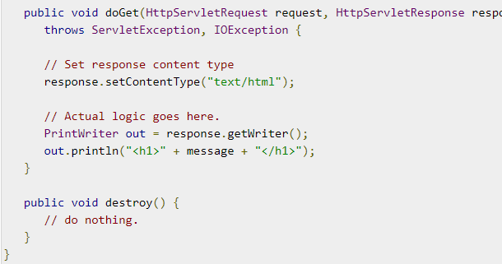

Slide 33



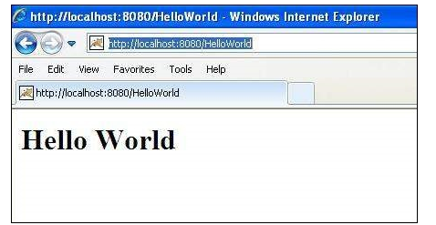
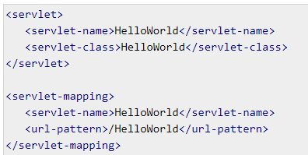
If everything goes fine, above compilation would produce HelloWorld.class file in the same directory.

